Slide 1
Rob the Bank
COMP6230

Slide 2
Our friend Rob is back!
My shop did so well, so many people bought unicorns! It’s time to expand!

Slide 3
Our friend Rob is back!
There’s always money in banking, it’s time to build a bank! I just need some PHP…

Slide 4
Rob the Bank
A chance to put your new skills to the test
Rob the Bank is full of security vulnerabilities
It’s your task to find them and exploit them!
Every time you to do, tell us about it!
This time it’s real
This is an individual assessed assignment
You are welcome to help each other, share tips, resources, tips and tricks and talk
But don’t share answers
It is obvious and we’ll find you!
Plus, you all have different answers!

Slide 5
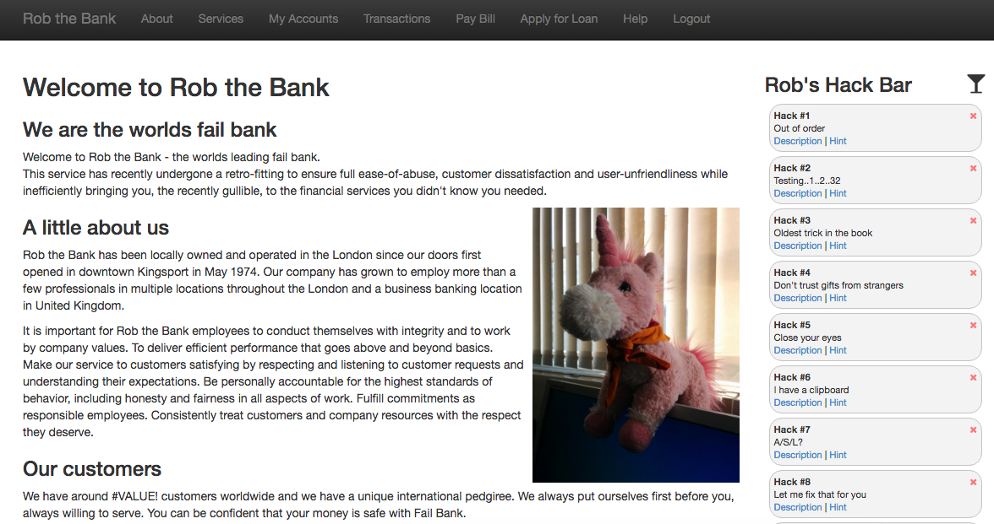
Rob the Bank

Slide 6
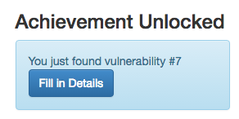

Slide 7
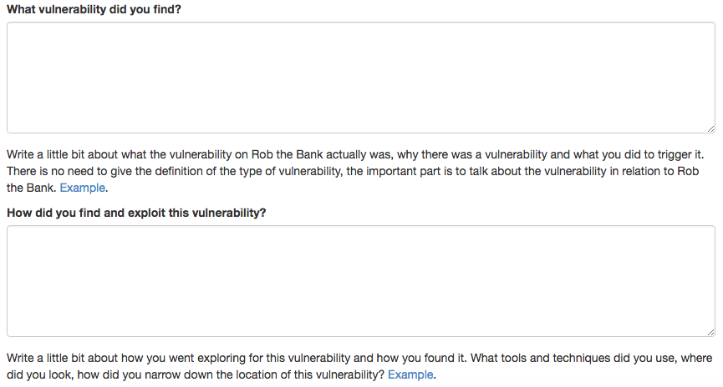

Slide 8
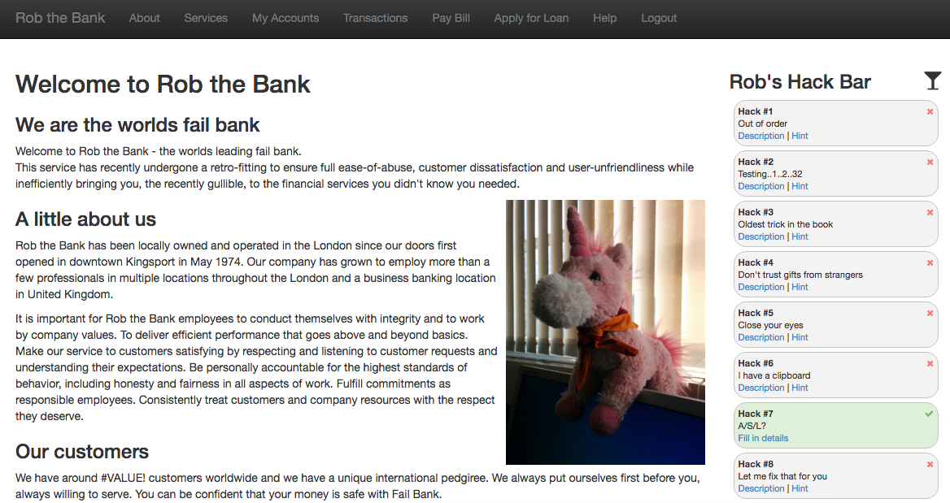

Slide 9
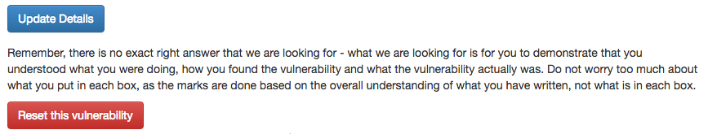
Finding vulnerabilities
Fill in the details as soon as you find a vulnerability
But you can always go back and edit it and add more
You can also reset the vulnerability
If you triggered something and you’re not sure why!

Slide 10
Rob the Bank
The marks are based on your documentation and understanding of the vulnerability, not just finding the vulnerability
Tell us what you found
What vulnerability did you find?
Why was it a vulnerability?
Tell us how you found it
What did it enable you to do?
How did you exploit it?

Slide 11
Rob the Bank
Don’t worry too much about what goes in which box
As long as you convey your understanding!
There are no exact right answers
But there are wrong ones
Don’t give me wikipedia or definitions!

Slide 12
Rules of Engagement
No Brute Forcing
Informed guessing is fine
Simple fuzzing is fine
Otherwise, you will get banned!
Don’t attack the infrastructure
Your scope is the web application
You are not looking for vulnerabilities in the server!
Do not try and hack the login function
Do not try and hack the submission function
Do not try and log in as other people
You must be logged in at all times
Otherwise, it won’t count

Slide 13
Today’s lab
Get set up
Learn the application
Learn how it works
Start mapping it out
Start having a play
Try out the tools
See if you can find anything obvious
Don’t panic! We’ll be going through what you need in the next lectures

Slide 14
Rob the Bank
https://robthebank.soton.ac.uk
NOTES:
http://secure.ecs.soton.ac.uk/notes/comp6230/1617/ofb/Lab2.pptx
Slides from today’s lecture
https://secure.ecs.soton.ac.uk/noteswiki/w/COMP6230-1617-ofb

